Slide 1

Weaponized WiFi Attack Tool
Hacking WPA for fun and profit
Jiaheng Wang @Alibaba Inc.
Jun Xie @Alibaba Inc.

Slide 2
About us
Jiaheng Wang Security Researcher @IoT security Research Team
Jun Xie Head of IoT Security Research Team in Alibaba
Focus on Internet Of Things Security Research, Reverse engineering, hardware hacking, Drones, Smart devices
Twitter:@vessial

Slide 3
Outline
Background
Man-One-The-Side(MOTS) Attack in WPA2 encrypted network
Side-Relay Attack On WPA Network
Attack Tools
Future work

Slide 4
Background
Brief of the well-known WPA/WPA2 standard

Slide 5
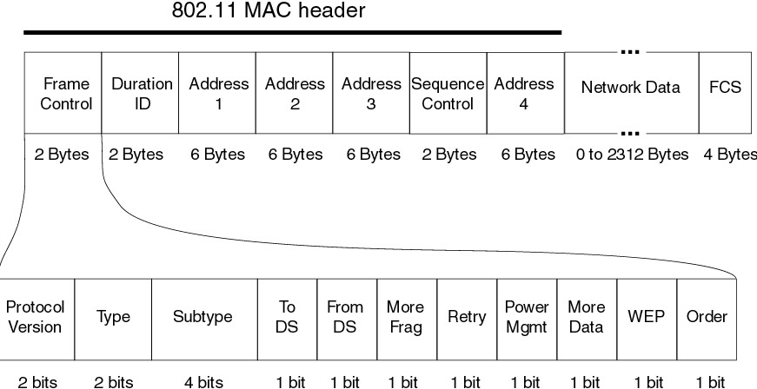
Background
WPA Encryption - Frame Control
Sequence Number
Data is encrypted or not

Slide 6
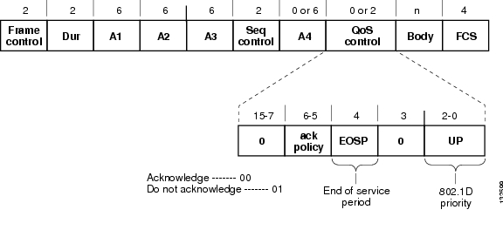
Background
WPA Encryption - QoS Data Packet
Type = 0x02
Subtype = 0x08

Slide 7

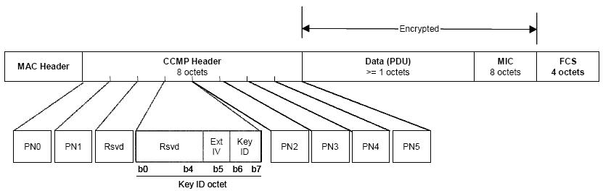
Background
WPA Encryption - QoS Data Packet Body
Packet Number(IV)

Slide 8
Attack in Encrypted Network
What is a good WLAN attack?
Hidden – No fake AP or connection needed.
Flexible – Support both 2.4G & 5G bands
Precision – Precisely attack to each single user.
Portable – Tool in tiny Size

Slide 9
Prerequisites for an attack
The ESSID(name) of the target AP
The BSSID (Mac address) of AP
The pre-shared password(or leak for PTK) of the network.(Just for key calculation)
The MAC address of the victim.

Slide 10
Attack in Action – Stage 1
Man-On-The-Side(MOTS) Attack in a WPA/WPA2 Encrypted Network
Example: DNS Spoof in Encrypted Network.

Slide 11
Attack in Action – Stage 1
DNS Spoof in Encrypted Network
Normal state

Slide 12
Attack in Action – Stage 1
DNS Spoof in Encrypted Network
Under Attack

Slide 13
Attack in Action – Stage 1
Important
Match sequence number
Correct Packet Number
Reconstruct QoS Data Packet

Slide 14
Attack in Action – Stage 1
DNS Spoof in Encrypted Network
Active De-authenticate the device and capture handshakes or Passive Capture new handshakes.
Calculate STA new PTK via the 4-way handshake
Reconstruct DNS response and inject back to network.

Slide 15
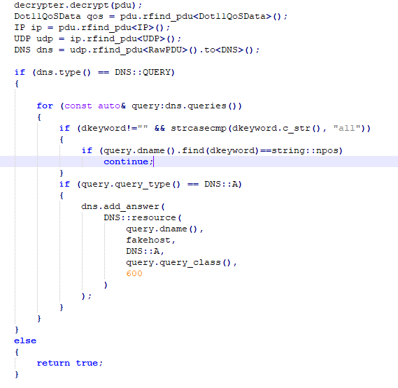
Attack in Action – Stage 1
DNS Spoof in Encrypted Network

Slide 16
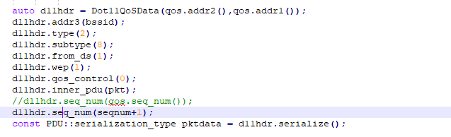
Attack in Action – Stage 1
DNS Spoof in Encrypted Network
Important! Match sequence number

Slide 17
Attack in Action – Stage 2
Attack in a WPA/WPA2 Encrypted Network
Stage 2:
DoS Attack

Slide 18
Attack in Action – Stage 2
DoS Attack
Set Packet Number to a large value
Normal State
Large PN Attack

Slide 19
Attack in Action – Stage 3
Side Relay Attack in a WPA/WPA2 Encrypted Network
Similar to MITM Attack
Attacker can modify 802.11 packet data retransfer to the victim.

Slide 20
Attack in Action – Stage 3
Side Relay Attack in a WPA/WPA2 Encrypted Network
Repack QoS data packet from AP

Slide 21
Attack in Action – Stage 3
Side Relay Attack Detail

Slide 22
Demos
Because of the attack effect depends on the wireless environment.
Live demo may not show good effect and need about 10min to setup.
To save time, we will show a video first.
If you are interested in a live demo.
Suggested to contact us after the talk.

Slide 23
DEMO Stage 1 MOTS Attack
Inject Fake DNS Packet to spoof the victim.

Slide 24
Demo Setup

Slide 25
DEMO Stage 2 PN DoS Attack
Inject Large Packet Number cause DoS to one victim.

Slide 26
Demo Setup

Slide 27
DEMO Stage 3 Side Relay Attack
Inject Large Packet Number cause DoS to one victim.
And then Relay Packet from AP with a modified PN to victim
(Data also can be modified)

Slide 28
Demo Setup
Assuming DoS Stage has succeeded.

Slide 29
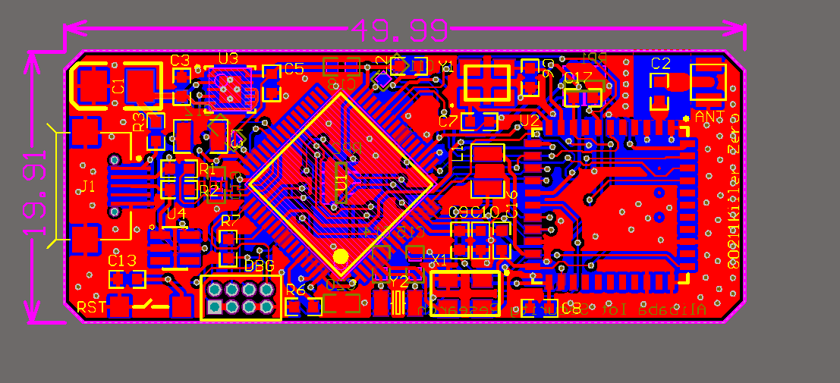
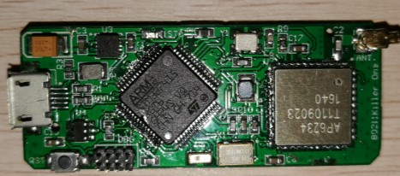
Attack Tool
80211Killer
Features:
BCM43340 Based
Support 2.4G and 5G band
OS: ThreadX 5.6
Tiny size
Any packet injection
Monitor mode
Portable

Slide 30
Attack Tool
Get Full control of BCM43340 80211MAC layer
Enable packet Injection (Thanks to nexmon[*] project.)
Get control of sequence number (patch d11 core microcode)
[*]See Here https://github.com/seemoo-lab/nexmon

Slide 31
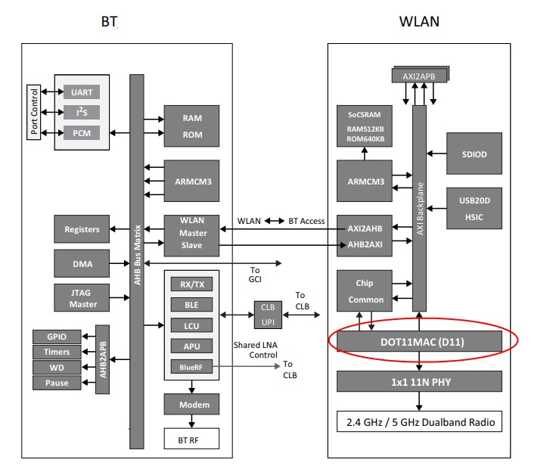
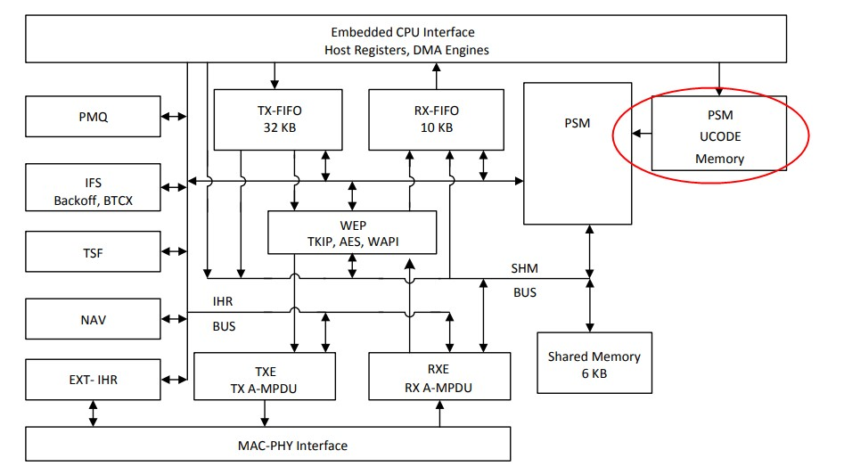
Attack Tool
Broadcom WLAN SoC

Slide 32
Attack Tool
b43 assemble
D11 Micro Code
*Original photo is stolen from Project Zero.
See here: http://goo.gl/zxzEK6

Slide 33
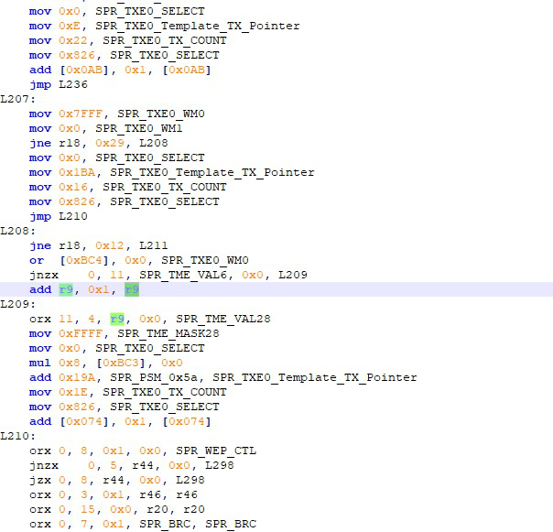
Attack Tool
b43 assemble
Undocumented
Ugly
Long and complicated

Slide 34
Attack Tool
b43 assemble
R9 - Probably Sequence Counter
Special Purpose Register 0EE
Sequence Control Field in TME
Notice: The register layout may
be different between chips

Slide 35
Attack Tool
Transmit Modify Engine(Simplified Graph)
microcode
Modify Duration/ID & Sequence Control
Firmware
TXE
TME
PHY

Slide 36
Attack Tool
But How to find the address of SPR0EE?
Differential Analysis

Slide 37

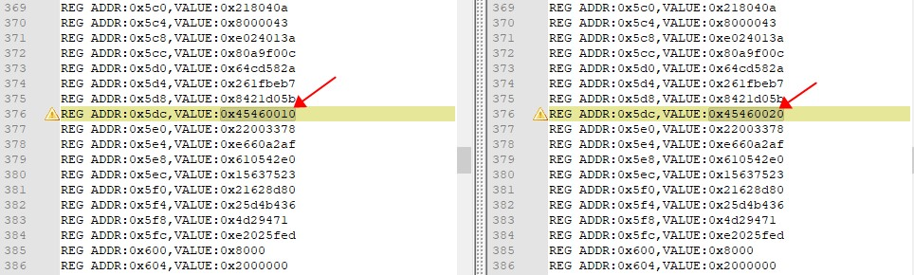
Attack Tool
Sequence Control Register
Address offset is 0x5dc
D11 Core Base is 0x18001000
Notice: 0x5dc is for bcm43340 soc, but for bcm4356 is 0x5e2

Slide 38
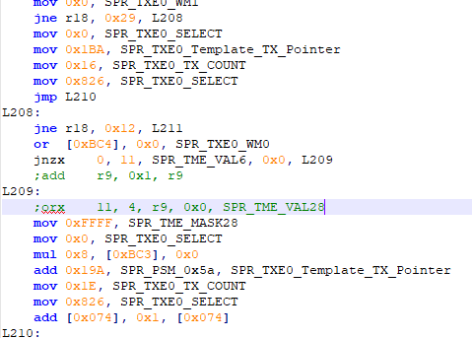
Attack Tool
Let’s Patch it!
Just comment it!! :P

Slide 39
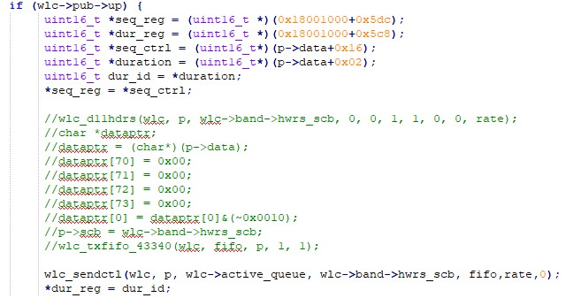
Attack Tool
Finally set sequence number in Firmware

Slide 40
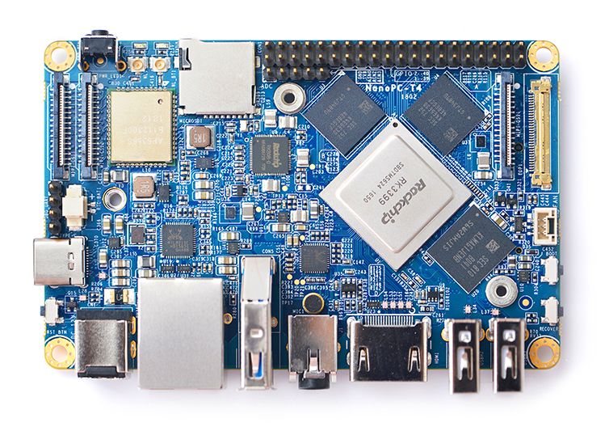
Attack Tool
Similar work also done on NanoPC T4
NanoPC T4 uses AP6356S(BCM4356) and support 2x2 MIMO
Provide higher performance

Slide 41
About capture capability
All attacks we introduced today is highly based on packet capture.
More powerful wireless card for capture will perform better in attack.
For 3x3 MIMO wireless card of victim, we need wireless card support 3x3 MIMO to capture the data packets.
For MU-MIMO wireless network, we should stay in the same petal with the victim.

Slide 42
Compare
 | MOTS | Side Relay Attack
Open Network | affected | Unaffected????
WPA/WPA2-Personal | affected | affected
WPA3-Personal[1] | Part affected* | Part affected*
WPA/WPA2/WPA3-Enterprise | Part affected* | Part affected*
[1]Notice: Wi-Fi Alliance announced that WPA3 uses Dragonfly Key Exchange Protocol, which provides forward secrecy. So we can’t reconstruct the TK just through the handshake packet and the pre-shared key.
*Though we can’t just reconstruct the TK from knowing password, it does not mean that the three attack can’t be performed.
If the TK is leaked in other way, the three attack also can be perfomed. So we mark as part affected.
It is also very interesting that the open network is not affected by Side Relay Attack.

Slide 43
What’s special of this attack?
In God View we believe(on 802.11 MAC layer)
Vulnerability or not vulnerability this is a question
Wi-Fi Jack
DNS hijack
IP hijack
TCP hijack
ARP spoof

Slide 44
Mitigation
Use WPA3
Deploy WPA/WPA2-Enterprise
Deploy 802.11w management frame protection.
Application use C2C/S trust compute model(e.g., trusted certificate auth)

Slide 45
Future work
Firmware Symbiotes on Wi-Fi chips
Building hardware fuzzing platform for Wi-Fi chips
Find baseband vulnerability to exploit Wi-Fi chip without PSK (e.g. BroadPwn)

Slide 46
Questions? Thank you

